Slide 1
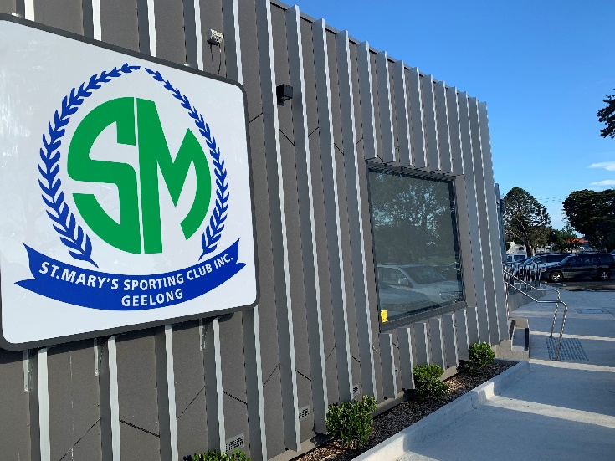
St Mary’s Sporting Club
Player Development Program
Proudly supported by Tony Costa

Slide 2
St Mary’s Sporting Club’s - Mission and Strategic Objectives
Mission:
To provide a club environment focused on excellence in all areas. This will enable the club to be a long term leader in football and netball management, and ensure club sustainability is achieved through supporting the growth of all its people.
Club Objectives:
Always demonstrate a positive image and reputation to the football, netball and broader local community.
Encourage parents and supporters to become part of, and continue to support St. Mary's at both team and club level.
Establish a development program which covers both life skills and sporting development. Every player will have an opportunity to be involved in the development program established to maximise their potential, and ensure their time at the club has been a learning experience and they have opportunities available and support to be become better people.
Provide an enjoyable, fun, comfortable, rewarding and safe environment for all people associated with the club with participation the key focus for all juniors at the club.
All people within the club work towards the same values of respect, supporting each other and hard work.

Slide 3
Player Development Program – Executive Summary
The St. Mary's Player Development Program is an ongoing journey aimed at continually identifying opportunities to develop our players and members. The program will be reviewed regularly and enhanced over time.
The program’s core goal will be to have development programs and infrastructure available to allow each player participating within the club an opportunity to maximise their development in both sport and life, and to ensure they get the most out of their time at the club.
The program will be set up to balance out education in off field issues such as drugs, bullying, alcohol and mental health struggles/issues such as depression, anxiety or eating disorders, along with providing for sporting development opportunities which will focus on allowing all players the facilities and programs to maximise their potential for whatever level of football or netball they are striving to achieve.
There will be no restrictions for any player wishing to be involved in the program which will be set up to maximise each persons opportunity to develop their sporting skills as well as put in place some support mechanisms to support them transitioning through their teen and adult years, with all of the society issues they will face.
To help support all players off field the club has appointed a number of welfare officers who players can approach confidentially, and get support for any issues and also be referred to particular experts outside of the club.

Slide 4
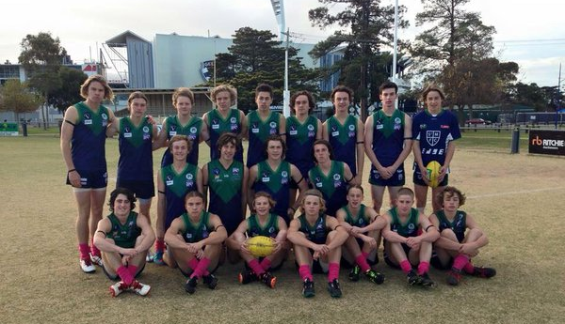
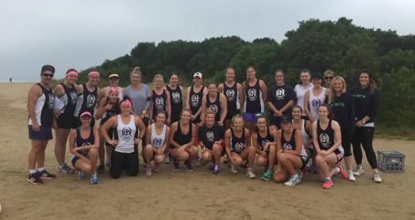
Player Development Strategy – Introduction…..
The club sees the Player Development Program as very important. In setting up the program the club sees itself as playing a huge role in giving every player the best opportunity to maximise their skills in sport but more importantly giving them support in developing life skills, especially at an age where they will come across many issues currently influencing young people.
If the club can change in a positive way the direction of one child through this program, whether that be supporting them through mental health struggles or other social issues then the investment in the program will have paid dividends.
The outcomes the club will be striving to achieve from the program is for any player who has had time at the club, that they have had the greatest opportunity to maximise their on-field talent, and become a better person off-field. All discussions with player welfare managers will be confidential.

Slide 5
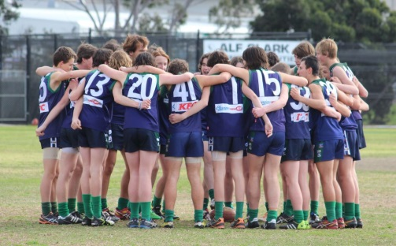
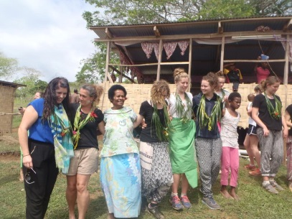
St Mary’s has broken its Player Development Strategy into off-field and on-field components….
Off-field Player Development
The off-field player development strategy is aimed at upskilling our players, and providing education around specific social issues that relate directly to our players. These education sessions and camps, will be a time for learning and discussions, and are aimed at ensuring our players make better decisions off field.
We firmly believe this program has the capacity to ensure our players have the skills, and are capable of making strong and respectful contributions to our community.
On-field Player Development
The on-field player development strategy is focused on the clubs commitment to investing in high quality coaching, resources, equipment and infrastructure, in order to allow the opportunity for all players to develop to their maximum on-field potential.

Slide 6
St Mary’s Sporting Club Development Pathway Summary for both football and netball…..
Off-Field Development
Playing Segment
On-Field Development
Greenlight Youth Driver Education Program
Drug and Alcohol Education Program
Respect and Responsibility Program
Leadership Program
Employment Transition Program
Sports Psychology Session
Access to Player Welfare Managers
Access to gymnasium and support via a Strength & Conditioning coach
Physiotherapist access
Sports Rehabilitation and Flexibility
Specialist Coaches
Sessions with experienced dietician
Injury prevention training session
Summer based program
Senior Football and Netball
(17 – Senior)
Cultural Exchange Overseas Trip
Kempe Read the Play
Weekend Camp at Cottage by the Sea – Including drug and bullying awareness discussions
Respect and Responsibility Program
Access to Player Welfare Manager
Access to gymnasium and support via a Strength & Conditioning coach
Summer based Player Development Program
Mentoring Program
Specialist Coaches
Youth Football and Netball
(13 –17)
Financial Support Program for families under duress
Respect and Responsibility Program
Access to Player Welfare Managers for parents and child
Junior Football and Netball
(Auskick –U12)
Participation focus
Basic fundamental training
Mentoring Program

Slide 7
Our off field focus with our Senior football and netball players is to support them with any issues and help them become great role models for our club…..
Off-Field Development
Senior Football and Netball - (17 – Seniors)
Program | Summary | Program Partner | Age group
Greenlight Youth Driver Education Program | Helping create safer drivers by offering quality, accessible, community- based driving courses. Includes education, financial information and advice around safe vehicles. 4 hour program for Age 18 – 25 age group. Please apply to the club welfare manager assigned to yourself. Limited spots available. No cost to participant. | Bendigo Bank | 18 – 25 years old
Drug and alcohol Education Program | Following on from the program ran for the 15 and 16 year age group there will be two education programs ran at the club in relation to drug education. All attempts will be made to ensure sessions have people who have been through addiction to share their story with all. | TBA | 18 – 30 years old
Respect and responsibility program | A program will be run on an annual basis covering off respect and your responsibility and the standards the Sporting club looks at setting in relation to this. Included will be discussions on respect for each other, women, club members and opposition. | TBA | All over 17
Leadership program | Senior footballers and netballers will have a tailored leadership program developed for all senior players to be taken through. Example football Cameron Ling and Jim Cail led. | TBA | All senior players
Employment Transition Program | All netballers and footballers can seek support through their club welfare officer in supporting them gain employment utilising contacts within the club to open up any opportunities. | TBA | All over 17
Sports Psychology session | The club will provide a session with a sports psychologist to speak to all players with an opportunity for one on one follow up sessions for any individual players. | TBA | All over 18
Access to player welfare managers | All football / netball issues should be escalated up through coach, team manager and junior coordinator. Any off field matters seeking support can be escalated to allocated player welfare manager. | Coaches / Managers | All over 17

Slide 8
Our on field focus with our Senior football and netball players is ensuring they reach their potential…..
On-Field Development
Senior Football and Netball - (17 – Seniors)
Program | Summary | Football / Netball | Age group
Access to fully functional gymnasium | St. Mary’s will continue its investment in the gymnasium to ensure the equipment available enables all players to access a wide range of good functioning equipment to support their development. Access to the gymnasium will remain available 24/7 via a pass code for all players | Both | 17 and over
Strength and conditioning coach | The club will provide the services of a trained strength and conditioning coach over summer and winter where players can book an appointment with to develop a specific program and ensure player properly trained in using gymnasium and has access to other exercise. | Both | 17 and over
Physiotherapist | The club will invest in a Physiotherapist being available at the club on a set day as agreed annually with senior coaches’ dependant on training days. | Both | 17 and over
Sports Rehabilitation | The club will develop a program for rehabilitation after a game which will include access to ice baths in the change rooms, plus information and referrals to specialists based on their injury or soreness. The club will also have available access to sports trainers. | Both | 17 and over
Flexibility | Ensure the program is set up to cater for both those wishing to develop to their greatest potential but also catering for those who just want to play sport to be with their friends and have fun. | Both | 17 and over
Specialist Coaches | The club will provide access to specialist coaches for players who want to do extra work on non - training nights. Example past years have had Matt Egan, Harry Taylor, Scott Selwood being at training one night a week for whole of club. | TBA | 17 and over
Dietician | The club will provide a session for players to attend with an experienced dietician to support them in selecting the appropriate diets for them to enhance their fitness. | Both | 17 and over
Summer Program | The club will develop an optional summer program to support players who want to do any extra work outside of normal training | Both | 17 and over

Slide 9
Our off field focus with youth players is providing them with the information to assist them in making the right decisions off field/court….
Off-Field Development
Youth Football and Netball – (13 – 17)
Program | Summary | Program Partner | Age group
Cultural Exchange overseas trip | Every alternate year every player from football and netball 16 and 17 year olds will be given an opportunity to participate in the bi-annual overseas cultural exchange trip. The netballers currently going to Fiji in every odd year and the boys to Sth Africa in every even year. Whilst playing football and netball overseas, the goal of the trip is to experience another culture and mix with people in a totally different environment all are used to. The club supports funding activities which goes towards subsidising all players going on these trips. | St Marys Sporting Club | 16 – 17 year olds
Kempe Read the Play | Program is in relation to raising youth awareness for drugs, alcohol and mental health. All netballers and footballers within the club will be taken through the program through a session at the club run by Kempe. Aim of program is to help players understand mental health problems, where to go to for help and how to support each other. | Kempe | 15 – 16 year olds
Weekend Camp at Cottage by the sea | Annual camp for both netball and football. Key aspects of the camp to cover leadership, respect, get to know each other, fun times along with some sessions which cover issues such as bullying, appropriate use of internet etc. Group work to discuss current things the age group is dealing with and sharing these experiences. | Cottage by the Sea | 13 – 14 year olds
Respect and responsibility program | All coaches will be briefed on having a major emphasis on passing onto players the importance of respect and responsibility. As well as respect for other people this will also cover respect for the club such as keeping change rooms clean, putting water bottles back etc. | TBA | All players
Access to player welfare managers | All football / netball issues should be escalated up through coach, team manager and junior coordinator. Any off field matters seeking support can be escalated to allocated player welfare manager. | Welfare Manager | All players & parents

Slide 10
Our on field / court focus with our youth players is focused on their physical and mental preparation for their football and netball….
On-Field Development
Youth Football and Netball – (13 – 17)
Program | Summary | Football / Netball | Age group
Access to fully functional gymnasium | St. Mary’s will continue its investment in the gymnasium to ensure the equipment available enables all players to access a wide range of good functioning equipment to support their development. Access to the gymnasium will remain available 24/7 via a pass code for all players too access. Club does not advise those younger than 16 to use gym unless approval given from parent. | All | 16-17
Summer Program | The club will develop an optional development program over summer for anyone interested. This will not be a pre season but a development program which will cover things such as running technique, skill sessions, dieticians session. Also look at sessions on proper use of gymnasium equipment and teach proper stretching techniques, establish some pre training routines and importance of rehabilitation. Look at gaining access to some elite facilities during summer e.g. Geelong Falcons Life balance / Goal setting – particularly for year 11 and year 12 students | All | 13-17
Mentoring program | The club will have senior players assigned to each side within the juniors to support them during the year at training and work as mentors for the players. | All | 13-17
Specialist Coaches | The club will provide access to specialist coaches for players who want to do extra work on non - training nights. Example Essendon Assistant Coach being at training one night a week in 2015 for whole of club. | TBA | 13-17

Slide 11
Our focus with our younger participants is to ensure they have every opportunity to enjoy and participate in football and netball…
Off-Field Development
Junior Football and Netball – (Auskick to 12)
Program | Summary | Program Partner | Age group
Support | A process will be available to work with the junior co-ordinator for any families who are experiencing financial difficulty to work with them to enable their child to participate in playing football or netball. | Cottage by the sea | 13 – 14 year olds
Respect and responsibility program | All coaches will be briefed on having a major emphasis on passing onto players the importance of respect and responsibility. As well as respect for other people this will also cover respect for the club such as keeping change rooms clean, putting water bottles back to team manager etc. | TBA | All players
On-Field Development
Program | Summary | Football / Netball | Age group
Participation | The whole focus of players at this level is participation and fun. All players should be rotated consistently with core focus on learning with winning way less important than the individual development of players. | Both | Age 6- 12
Basics | Introduce players to basic skills and commence learning of key aspects of football with having fun still the main critieria | Both | Age 6- 12
Mentoring program | The club will have senior players assigned to each side within the juniors to support them during the year at training and work as mentors for the players. | TBA | Age 6- 12

Slide 12
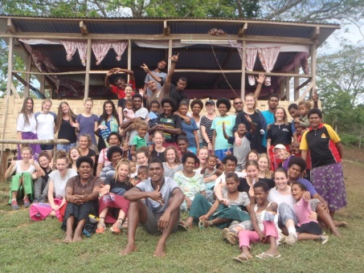
International development trips are a real highlight for our football and netball players…..
Every alternate year the St Mary’s Sporting Club gives all boys and girls aged 16 and 17 an opportunity to travel on an overseas cultural exchange trip. Endorsed by the Australian Football League and Netball Victoria, St Mary’s is the only club in Australia who runs such a program which has been hugely beneficial for both the boys and girls at the club.
Over the two week trip they partake in a large number of activities supporting local communities including things such as:
Running netball and football clinics in local communities
Playing matches
Visiting orphanages and supporting the communities through different activities
Donating luggage space to take over equipment

Slide 13
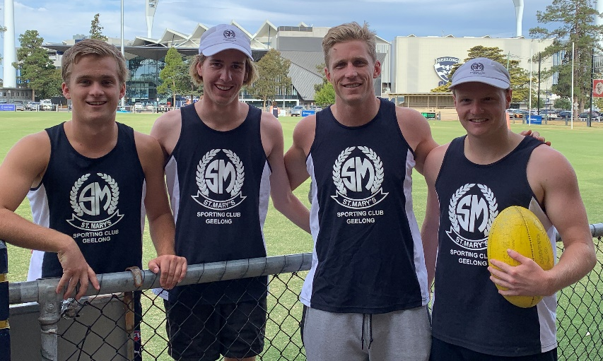
Development of our St Mary’s Coaches…..
All our Coaches are accredited
Our coaches have access to attend the AFL Coaching Conference and netball coaching requirements and seminars
A junior coaching mentor will be appointed with meetings to be held throughout the year with all junior coaches to ensure consistency and support them. This will allow player development and participation to remain the main focus
All coaches to provide equal development opportunities for all players regardless of ability.
All coaches are committed to working together for the benefit of all junior players within the club.
All coaches will be supported with access to equipment to enhance their ability to develop all players.
In 2020 Scott Selwood (current Collingwood Assistant Coach, former West Coast & Cats player) was appointed as a specialist development coach and attended training sessions supporting both senior and junior players along with mentoring the senior coaching staff.

Slide 14
Football Coaching Curriculum…..
The St Mary’s Football Coaching Program is overseen by our Coaching Coordinator who implements a coaching curriculum aimed at the continuous development of our players.
Colts Football (U17 –U18.5)
Match simulations practice
Style of play and defensive skills
Consistent with senior game plan
Dynamic kicking skills
Longer training drills for kicking and handballing
Align all coaching styles to be consistent across sides
Maximise assistant coaches at training to encourage more development
Upper Youth Football (U15 –U16)
Lower Youth Football (U13 –U14)
Basic kicking skills
Provide environment to ensure develop high performers but also cater for those just wanting to have fun.
Heaps of touches of football
Fun training and even participation
Small sided games
No lines…lots of footballs
Junior Football (U9 –U12)
NAB AFL Auskick
Small sided games
No lines…lots of footballs and lots of touches for everyone
Fun training and even participation

Slide 15
Netball Coaching Curriculum….
The St Mary’s Netball program is overseen by our A Grade Coach Renee Garing who develops coaching resources aimed at the continuous development of our players.
Match simulations practice
Advanced ball skills, passing, defence, shooting, centre court skills
Advanced knowledge of all playing positions/systems
Align all coaching styles to be consistent across sides
Netball (Seniors)
Advanced ball skills, passing, defence, shooting, centre court skills
Advanced knowledge of all playing positions/systems
Saturday graded teams, Friday graded teams, fun training & competition
Align all coaching styles to be consistent across sides
Upper Youth Netball (U17)
Lower Youth Netball (U15)
Intermediate ball skills, passing, defence, shooting, centre court skills
Intermediate knowledge of all playing positions/systems
Saturday graded teams, Friday graded teams, fun training & competition
Junior Netball
(U13)
Development ball skills, passing, defence, shooting, centre court skills
Development knowledge of all playing positions/systems
Saturday graded teams, Friday graded teams, fun training & competition
Junior Netball
(U11)
Foundation ball skills
Foundation knowledge of all playing positions
Fun training and even participation

Slide 16
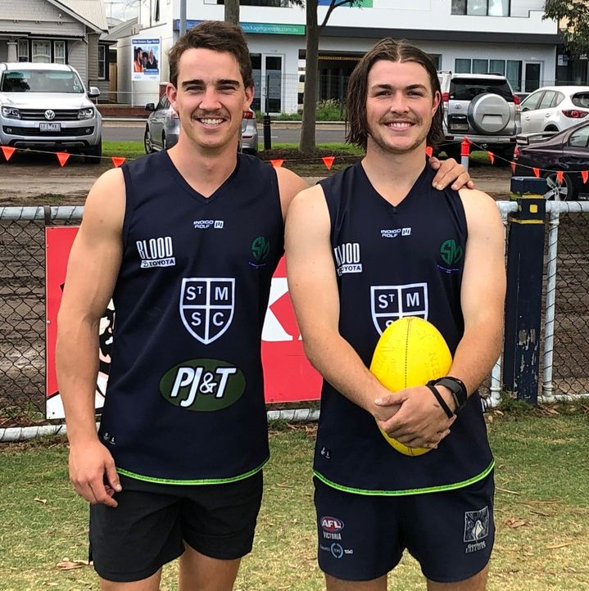
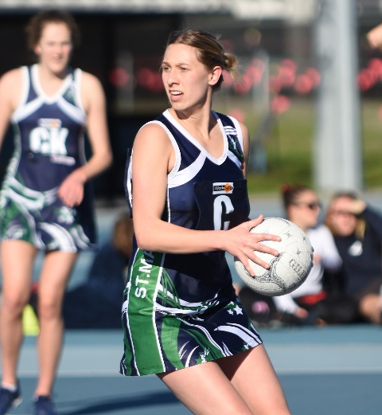
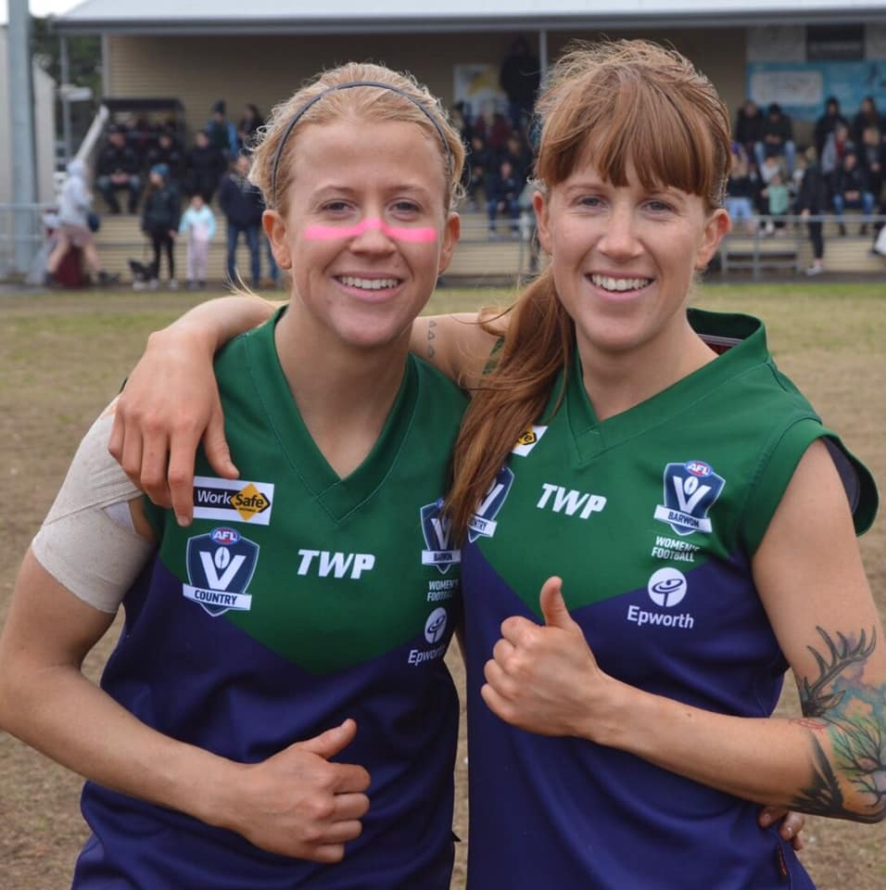
Senior St Mary’s player involvement and transition…
Senior St Mary’s players, will participate and play a role at all levels of our junior structure. The seniors will also be involved with junior sides and commence a mentor program making the transition to senior ranks a lot easier for younger players.
The club will expand on its current program to ensure there is a smooth path for anyone aiming for a higher standard of football or netball. The club wishes to maintain the momentum from the current successful program where over 10 players in each of the past 5 years made the final list for the Geelong Falcons. The netball program will also be continually enhanced to allow a pathway for those wanting to play at the highest level possible. Both netball and football will always have a place though for those just wanting to participate and have fun with no higher level goals.
Opportunities also exist to train with the senior squad over preseason for all U18 players.

Slide 17
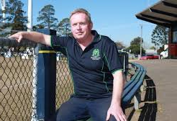
The role parents play in making St Mary’s stronger and providing our kids with even more opportunities…..
The club understands how busy people are, but have been lucky to be supported with a fantastic group of parents who support the development programs.
Many hands make light work, so the club will be looking to create opportunities for others to become involved to support the program, which will enhance the opportunity to further develop our people, and make the experience for football and netballers participants the best it can be.
Volunteering in any aspect is encouraged, whether it be helping out two nights a year at training, or taking a role on match day to allow the coach to spend more time with the players.

Slide 18
Contacts and resources…
Name | Role | Contact
Damian McKeegan | NAB AFL Auskick – U12 Player Welfare Manager | 0423 021 258
Kevin McMahon | U14 – U16 Player Welfare Manager | 0457 507 202
Mitch Etherton | Senior Player Welfare Manager | 0409 100 092
Fiona Greig | Junior Netball Welfare Manager | 0438 011 016
Renee Garing | Senior Netball Welfare Manager | 0400 690 456
Madison Koehler | Senior Netball Welfare Manager | 0468 646 972
Health Referral Contacts
Name | Role | Contact
Barwon Health | Drug and Education | 1300 094 187
Head Space Barwon | Youth Health Services (12 – 25) | 5222 6690
Family Drug Support Australia | Supporting families affected by drugs and alcohol | 1300 368 186
Beyond Blue | Anxiety / Depression | 1300 22 4636

